Slide 1

Demonbane: Castle of Eternal Night
Game Design Analysis Presentation

Slide 2

What Hasn’t Changed
Story is unchanged
Movement controls are unchanged
Aesthetic and theme of levels is unchanged
Tileset and world assets are unchanged

Slide 3
What Has Changed
Pickup/score system implemented in the form of “gems”
Music and sound effects changed from initial plan
Dodge-roll mechanic implemented
Game art added that matches the “Dark” aesthetic
Attack controls changed
Enemies with AI added
Spike Traps added

Slide 4
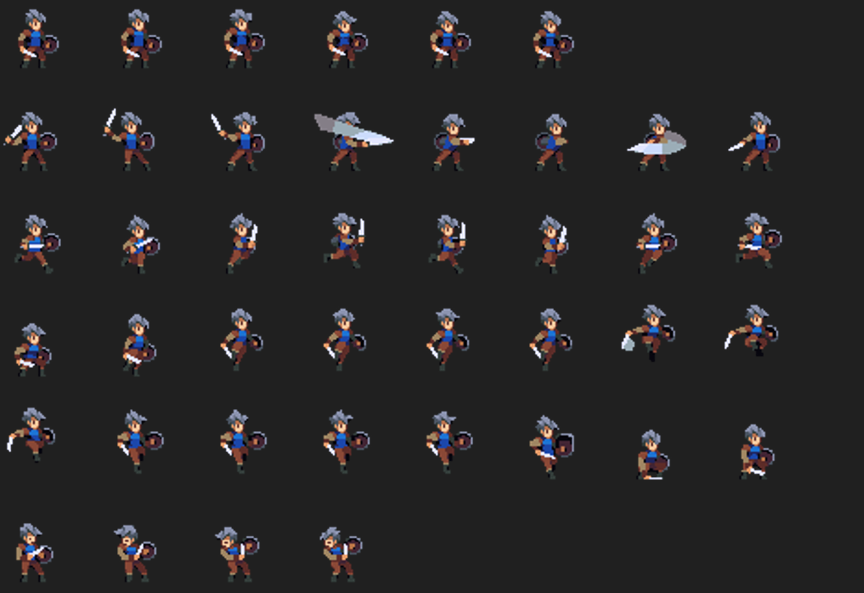
Comparison between Sprites for Character
Old sprites that were unused
Asset sprite set we chose for final design

Slide 5
Overview of Enemies: Used and Unused
Goblin and Skeleton used
Mushroom unused
Flying Eye scrapped due to
physics issues with flying
movement
Both used enemies have an
attack, death, damage, idle
and walk animation

Slide 6
Complications
During development we ran into a multitude of bugs that were somewhat ironed out, however due to import issues and copying some assets from one another, faults occurred in the game. The state of the game differs over our systems, due to these importing issues. For instance, Carl cannot run Slade’s levels because the tilemap does not import properly. The level would have to be rebuilt from scratch. However, we do individually have each of our levels completed to a playable state. This is basically a disclaimer to explain the “jank” that you might see while playing. We apologize for this in advance.

